Slide 1
CSE322 REGULAR EXPRESSION

Slide 2
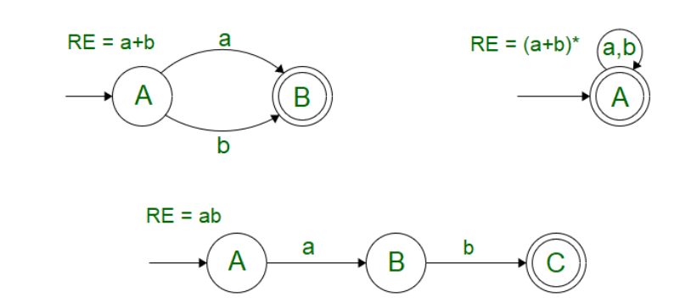
Rules used for Regular expression
Union, Concatenation, Closure

Slide 3
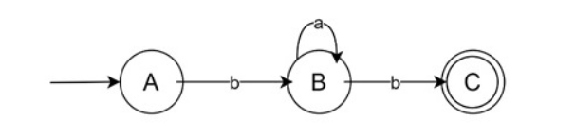
Construction of Finite Automata Equivalent to a Regular Expression
1. ba* b
This design will accept strings like bb, bab, baab, etc.

Slide 4
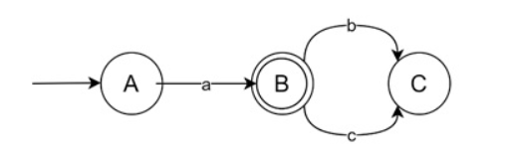
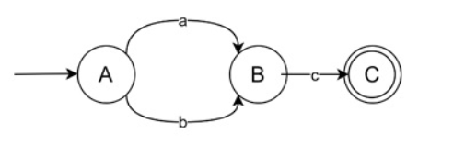
Other Examples
2. (a+b)c
3. a (bc)*

Slide 5
Equivalence of Two Regular Expression
(1+00* 1)+(1+00* 1)(0+10*1)*(1+10*1)=0*1(0+10*1)*

Slide 6
Equivalence of Two Regular Expression
(00* (01)*0)+ 0*(10*)*=(0+10)*

Slide 7
Closure Properties of Regular Sets
Union of regular set is regular.
Intersection of regular set is regular.
Complement of regular set is regular.
Difference of regular set is regular.

Slide 8
Closure Properties of Regular Sets
Reversal of regular set is regular.
Eg:- L = {01, 10, 11, 10} , LR = {10, 01, 11, 01}
Closure of regular set is regular.
Concatenation of regular sets is regular.

